Slide 1
Graduate Artificial Intelligence CS 640 Training by Backpropagation
Jeffrey Considine
jconsidi@bu.edu

Slide 2
Plan for Today
Why calculate gradients?
Backpropagation intuition
Backpropagation example
Backpropagation with matrices

Slide 3
Loss function
Training dataset of I pairs of input/output examples:
Loss function or cost function measures how bad model is:
or for short:
Returns a scalar that is smaller when model maps inputs to outputs better
Slide originally by Simon Prince

Slide 4
Example
Slide originally by Simon Prince

Slide 5
Problem 1: Computing gradients
Loss: sum of individual terms:
SGD Algorithm:
Parameters:
Need to compute gradients
Slide originally by Simon Prince

Slide 6
Why is this such a big deal?
A neural network is just an equation:
But it’s a huge equation, and we need to compute derivative
for every parameter
for every point in the batch
for every iteration of SGD
Slide originally by Simon Prince

Slide 7
Any Questions?
Moving on
???
Why calculate gradients?
Backpropagation intuition
Backpropagation example
Backpropagation with matrices

Slide 8
What is Backpropagation?
An efficient way to compute gradients using the chain rule.
Forward pass: compute and save all intermediate values of the computation.
Backward pass: compute gradients with respect to all intermediate values using the chain rule.
Computation cost ~2x a normal function evaluation.
But need to save all the intermediate values.

Slide 9
BackProp intuition #1: the forward pass
Orange weight multiplies activation (ReLU output) in previous layer
We want to know how change in orange weight affects loss
If we double activation in previous layer, weight will have twice the effect
Conclusion: we need to know the activations at each layer.
Slide originally by Simon Prince

Slide 10
BackProp intuition #2: the backward pass
To calculate how a small change in a weight or bias feeding into hidden layer h₃ modifies the loss, we need to know:
how a change in layer h₃ changes the model output f
how a change in model output changes the loss l
Slide originally by Simon Prince

Slide 11
BackProp intuition #2: the backward pass
To calculate how a small change in a weight or bias feeding into hidden layer h₂ modifies the loss, we need to know:
how a change in layer h₂ affects h₃
how h₃ changes the model output
how this output changes the loss
Slide originally by Simon Prince

Slide 12
BackProp intuition #2: the backward pass
To calculate how a small change in a weight or bias feeding into hidden layer h₁ modifies the loss, we need to know:
how a change in layer h₁ affects layer h₂
how a change in layer h₂ affects layer h₃
how layer h₃ changes the model output
how the model output changes the loss
Slide originally by Simon Prince

Slide 13
Any Questions?
Moving on
???
Why calculate gradients?
Backpropagation intuition
Backpropagation example
Backpropagation with matrices

Slide 14
Toy function
Consists of a series of functions that are composed with each other.
Unlike in neural networks just uses scalars (not vectors)
“Activation functions” sin, exp, cos
Slide originally by Simon Prince

Slide 15
Toy function
Derivatives
Slide originally by Simon Prince

Slide 16
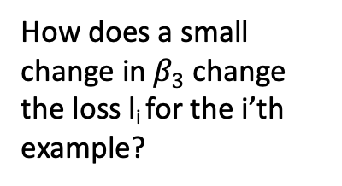
Gradients of toy function
We want to calculate:
How does a small
change in${ β}_{3}$change the loss l_{i} for the i’th example?
Slide originally by Simon Prince

Slide 17
Gradients of composed functions
Calculating expressions by hand:
some expressions very complicated.
obvious redundancy (look at sin terms in bottom equation)
Slide originally by Simon Prince

Slide 18
Forward pass
1. Write this as a series of
intermediate calculations
2. Compute these intermediate quantities
Slide originally by Simon Prince

Slide 19
Forward pass
1. Write this as a series of
intermediate calculations
2. Compute these intermediate quantities
Slide originally by Simon Prince

Slide 20
Forward pass
1. Write this as a series of
intermediate calculations
2. Compute these intermediate quantities
Slide originally by Simon Prince

Slide 21
Backward pass
1. Compute the derivatives of the loss with respect to these intermediate quantities, but in reverse order.
Slide originally by Simon Prince

Slide 22
Backward pass
1. Compute the derivatives of the loss with respect to these intermediate quantities, but in reverse order.
Slide originally by Simon Prince

Slide 23
Backward pass
1. Compute the derivatives of the loss with respect to these intermediate quantities, but in reverse order.
The first of these derivatives is trivial
Slide originally by Simon Prince

Slide 24
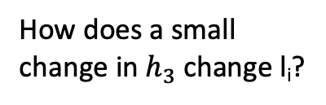
Backward pass
1. Compute the derivatives of the loss with respect to these intermediate quantities, but in reverse order.
The second of these derivatives is computed via the chain rule
How does a small
change in${ h}_{3}$change l_{i}?
Slide originally by Simon Prince

Slide 25
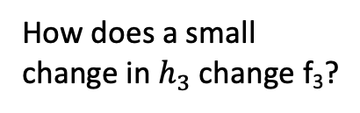
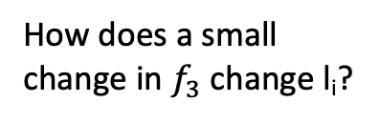
Backward pass
1. Compute the derivatives of the loss with respect to these intermediate quantities, but in reverse order.
The second derivative is computed via the chain rule
How does a small
change in${ f}_{3}$change l_{i}?
How does a small
change in${ h}_{3}$change l_{i}?
How does a small
change in${ h}_{3}$change f₃?
Slide originally by Simon Prince

Slide 26
Backward pass
1. Compute the derivatives of the loss with respect to these intermediate quantities, but in reverse order.
The second of these derivatives is computed via the chain rule
Already computed!
How does a small
change in${ h}_{3}$change l_{i}?
ω₃
Slide originally by Simon Prince

Slide 27
Backward pass
1. Compute the derivatives of the loss with respect to these intermediate quantities, but in reverse order.
The remaining derivatives also calculated by further use of chain rule
Slide originally by Simon Prince

Slide 28
Backward pass
1. Compute the derivatives of the loss with respect to these intermediate quantities, but in reverse order.
The remaining derivatives also calculated by further use of chain rule
Already computed!
-sin[f₂]
Slide originally by Simon Prince

Slide 29
Backward pass
1. Compute the derivatives of the loss with respect to these intermediate quantities, but in reverse order.
The remaining derivatives also calculated by further use of chain rule
Slide originally by Simon Prince

Slide 30
Backward pass
1. Compute the derivatives of the loss with respect to these intermediate quantities, but in reverse order.
The remaining derivatives also calculated by further use of chain rule
Slide originally by Simon Prince

Slide 31
Backward pass
1. Compute the derivatives of the loss with respect to these intermediate quantities, but in reverse order.
The remaining derivatives also calculated by further use of chain rule
Slide originally by Simon Prince

Slide 32
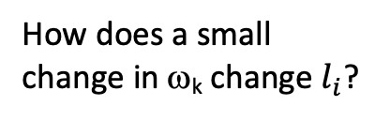
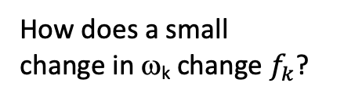
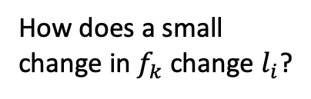
Backward pass
2. Find how the loss changes as a function of the parameters β and ω.
Another application of the chain rule
How does a small
change in${ f}_{k}$change $l_{i}$?
How does a small
change in$\text{w}\text{k}$ change $l_{i}$?
How does a small
change in$\text{w}\text{k}$ change${ f}_{k}$?
Slide originally by Simon Prince

Slide 33
Backward pass
2. Find how the loss changes as a function of the parameters β and ω.
Another application of the chain rule
Already calculated in part 1.
How does a small
change in$\text{w}\text{k}$ change $l_{i}$?
h_{k}
Slide originally by Simon Prince

Slide 34
Backward pass
2. Find how the loss changes as a function of the parameters β and ω.
Another application of the chain rule
Similarly for β parameters
Slide originally by Simon Prince

Slide 35
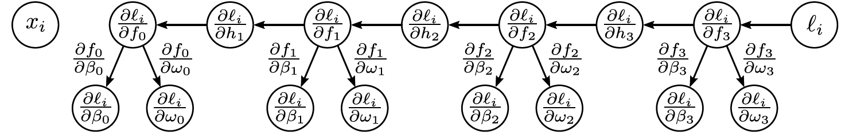
Backward pass
2. Find how the loss changes as a function of the parameters β and ω.
Slide originally by Simon Prince

Slide 36
Any Questions?
Moving on
???
Why calculate gradients?
Backpropagation intuition
Backpropagation example
Backpropagation with matrices

Slide 37
Matrix calculus
Scalar function f[] of a vector a
Slide originally by Simon Prince

Slide 38
Matrix calculus
Scalar function f[] of a matrix A
Slide originally by Simon Prince

Slide 39
Matrix calculus
Vector function f[] of vector a
Slide originally by Simon Prince

Slide 40
Comparing vector and matrix
Scalar derivatives:
Slide originally by Simon Prince

Slide 41
Comparing vector and matrix
Scalar derivatives:
Matrix derivatives:
Slide originally by Simon Prince

Slide 42
Comparing vector and matrix
Scalar derivatives:
Matrix derivatives:
Slide originally by Simon Prince

Slide 43
The forward pass
1. Write this as a series of
intermediate calculations
Slide originally by Simon Prince

Slide 44
The forward pass
1. Write this as a series of
intermediate calculations
2. Compute these intermediate quantities
Slide originally by Simon Prince

Slide 45
The backward pass
Slide originally by Simon Prince
1. Write this as a series of
intermediate calculations
2. Compute these intermediate quantities
3. Take derivatives of output with respect to intermediate quantities

Slide 46
The backward pass
Slide originally by Simon Prince
1. Write this as a series of
intermediate calculations
2. Compute these intermediate quantities
3. Take derivatives of output with respect to intermediate quantities

Slide 47
Yikes!
But:
Quite similar to:
Slide originally by Simon Prince

Slide 48
The backward pass
Slide originally by Simon Prince
1. Write this as a series of
intermediate calculations
2. Compute these intermediate quantities
3. Take derivatives of output with respect to intermediate quantities

Slide 49
The backward pass
Slide originally by Simon Prince
1. Write this as a series of
intermediate calculations
2. Compute these intermediate quantities
3. Take derivatives of output with respect to intermediate quantities

Slide 50
Derivative of ReLU
Slide originally by Simon Prince

Slide 51
Derivative of ReLU
“Indicator function”
Slide originally by Simon Prince

Slide 52
Derivative of RELU
where:
1. Consider:
2. We could equivalently write:
3. Taking the derivative
4. We can equivalently pointwise multiply by diagonal
Slide originally by Simon Prince

Slide 53
The backward pass
1. Write this as a series of
intermediate calculations
2. Compute these intermediate quantities
3. Take derivatives of output with respect to intermediate quantities

Slide 54
The backward pass
1. Write this as a series of
intermediate calculations
2. Compute these intermediate quantities
3. Take derivatives of output with respect to intermediate quantities
4. Take derivatives w.r.t.
parameters
Slide originally by Simon Prince

Slide 55
The backward pass
1. Write this as a series of
intermediate calculations
2. Compute these intermediate quantities
3. Take derivatives of output with respect to intermediate quantities
4. Take derivatives w.r.t.
parameters
Slide originally by Simon Prince

Slide 56
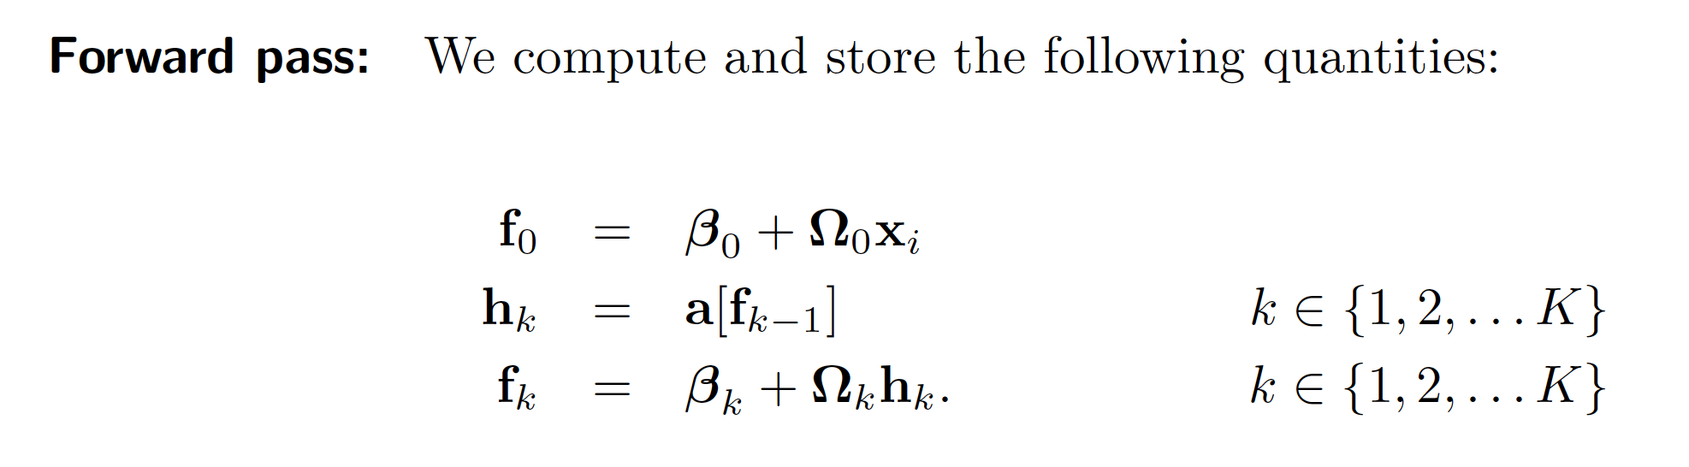
Backprop summary
Slide originally by Simon Prince

Slide 57
Backprop summary
Slide originally by Simon Prince

Slide 58
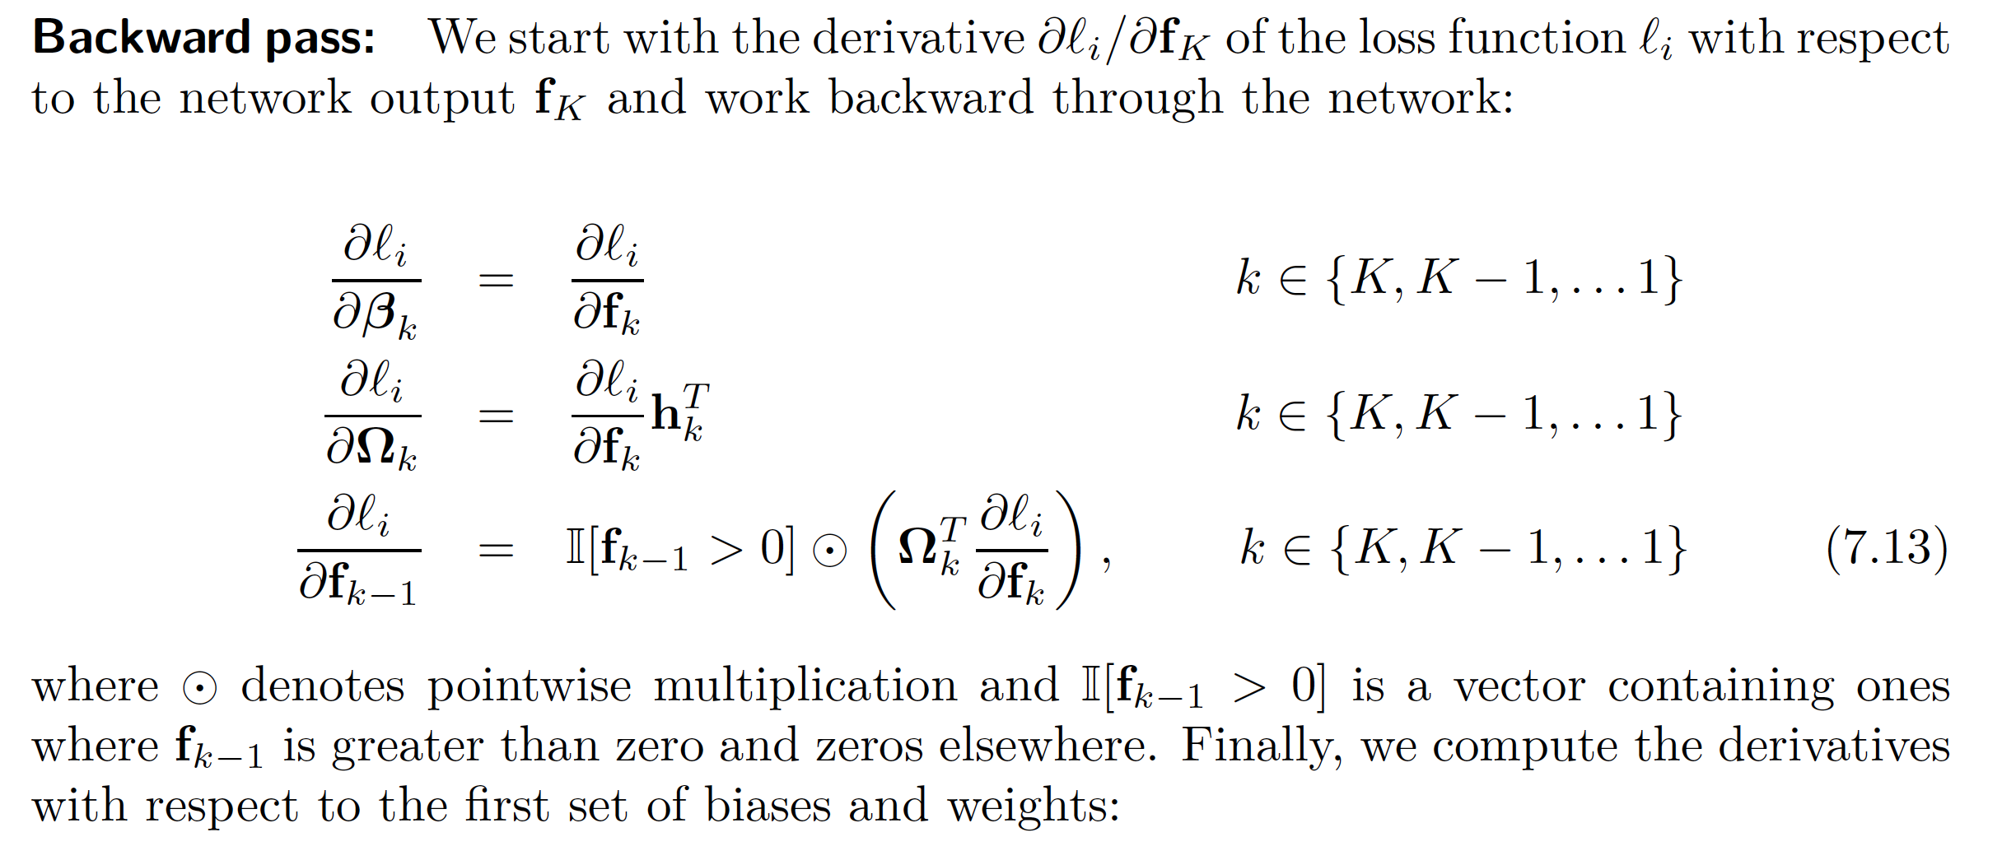
Backprop summary
Slide originally by Simon Prince

Slide 59
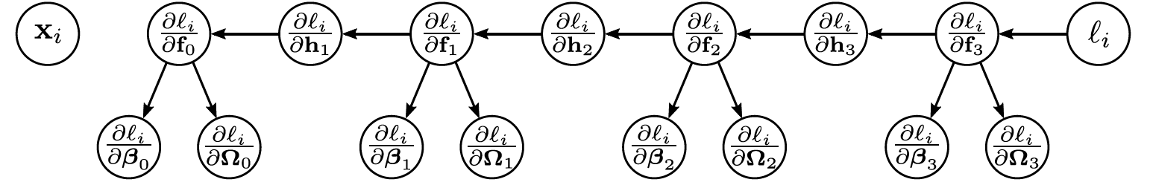
Backprop summary
Slide originally by Simon Prince

Slide 60
Backprop summary
Slide originally by Simon Prince

Slide 61
Backprop summary
Slide originally by Simon Prince

Slide 62
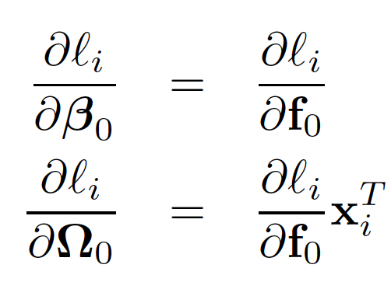
Backprop summary
Slide originally by Simon Prince

Slide 63
Pros and cons
Extremely efficient
Only need matrix multiplication and thresholding for ReLU functions
Memory hungry – must store all the intermediate quantities
Sequential
can process multiple batches in parallel
but things get harder if the whole model doesn’t fit on one machine.
Slide originally by Simon Prince

Slide 64
Any Questions?
Moving on
???
Why calculate gradients?
Backpropagation intuition
Backpropagation example
Backpropagation with matrices

